Slide 1
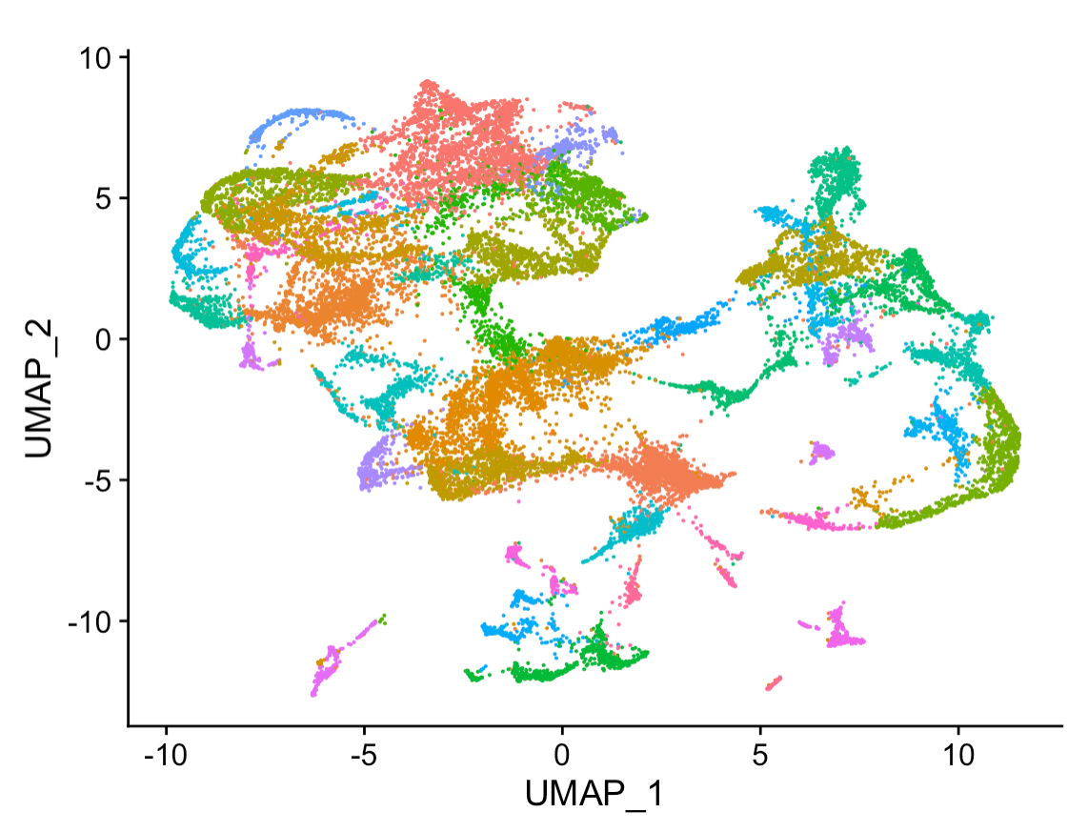
Good Data Practices For Machine Learning
Data4ML
Summer 2022

Slide 2
Ask an AI
The most important thing to review at the beginning of a machine learning workshop is the data that you will be working with. This is because the data will determine what kind of machine learning algorithms can be used, and how the data should be prepared for use with those algorithms.
The most important thing to consider when using sequencing data for machine learning projects is the quality of the data. Poor quality data can lead to inaccurate results and poor performance from machine learning models.
When working with sequencing data, it is important to check the quality of the data before using it for machine learning. There are a number of ways to assess data quality, including looking at the overall sequence quality, assessing the quality of the reads, and checking for any biases in the data.
Once the quality of the data has been assessed, it is important to pre-process the data to ensure that it is ready for use in machine learning. This may involve quality control steps, such as removing low-quality reads, trimming adapters, and normalizing the data.
After the data has been pre-processed, it is ready to be used in machine learning. There are a variety of machine learning algorithms that can be used with sequencing data, including classification, regression, and clustering algorithms.

Slide 3
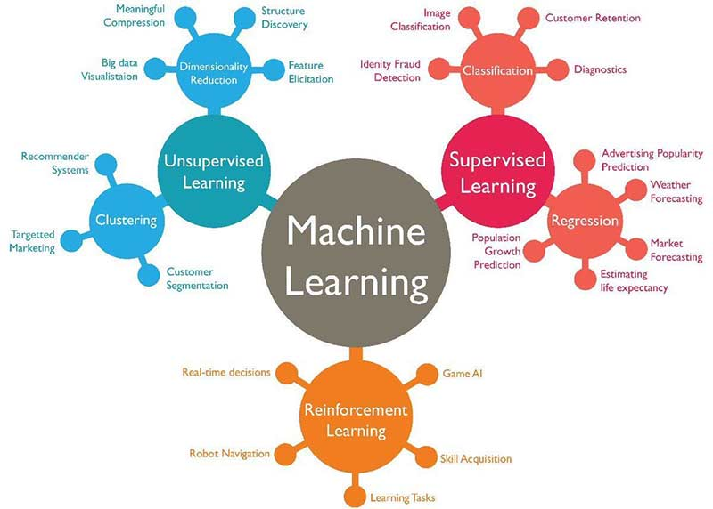

Slide 4
ML Experiment
Define your problem
Gather preliminary or existing data
Fit a test model
Use a learning curve fit to estimate how much more data you might need
Use importance or attribution to look for confounders that might affect your data
Gather data and experiment with new models
Deploy/Publish – Return to 6

Slide 5
Data Concepts
Good Machine Learning starts with good datasets
What makes a dataset ‘good’
Reproducible
‘FAIR’ – Finable Accessible Interoperable and Reusable
AI-Ready
How to plan out your data taking
What makes a data set ‘AI-Ready’

Slide 6
AI-Ready Data
Clear Data Splits
Designate some examples as training data
Designate some examples as testing data
Structed Data is ‘Tidy’ - https://vita.had.co.nz/papers/tidy-data.pdf
Every column is a variable.
Every row is an observation.
Every cell is a single value
The Dataset is Clean
No missing values or ‘Nans’
No ‘bad’ data
Consistent as Possible

Slide 7
ML Data Content
ML models are programed with data
Beyond technical requirements the content of the data is important
What is in your data determines how your model works
Will it generalize
Will it be able to train
How accurate will it be

Slide 8
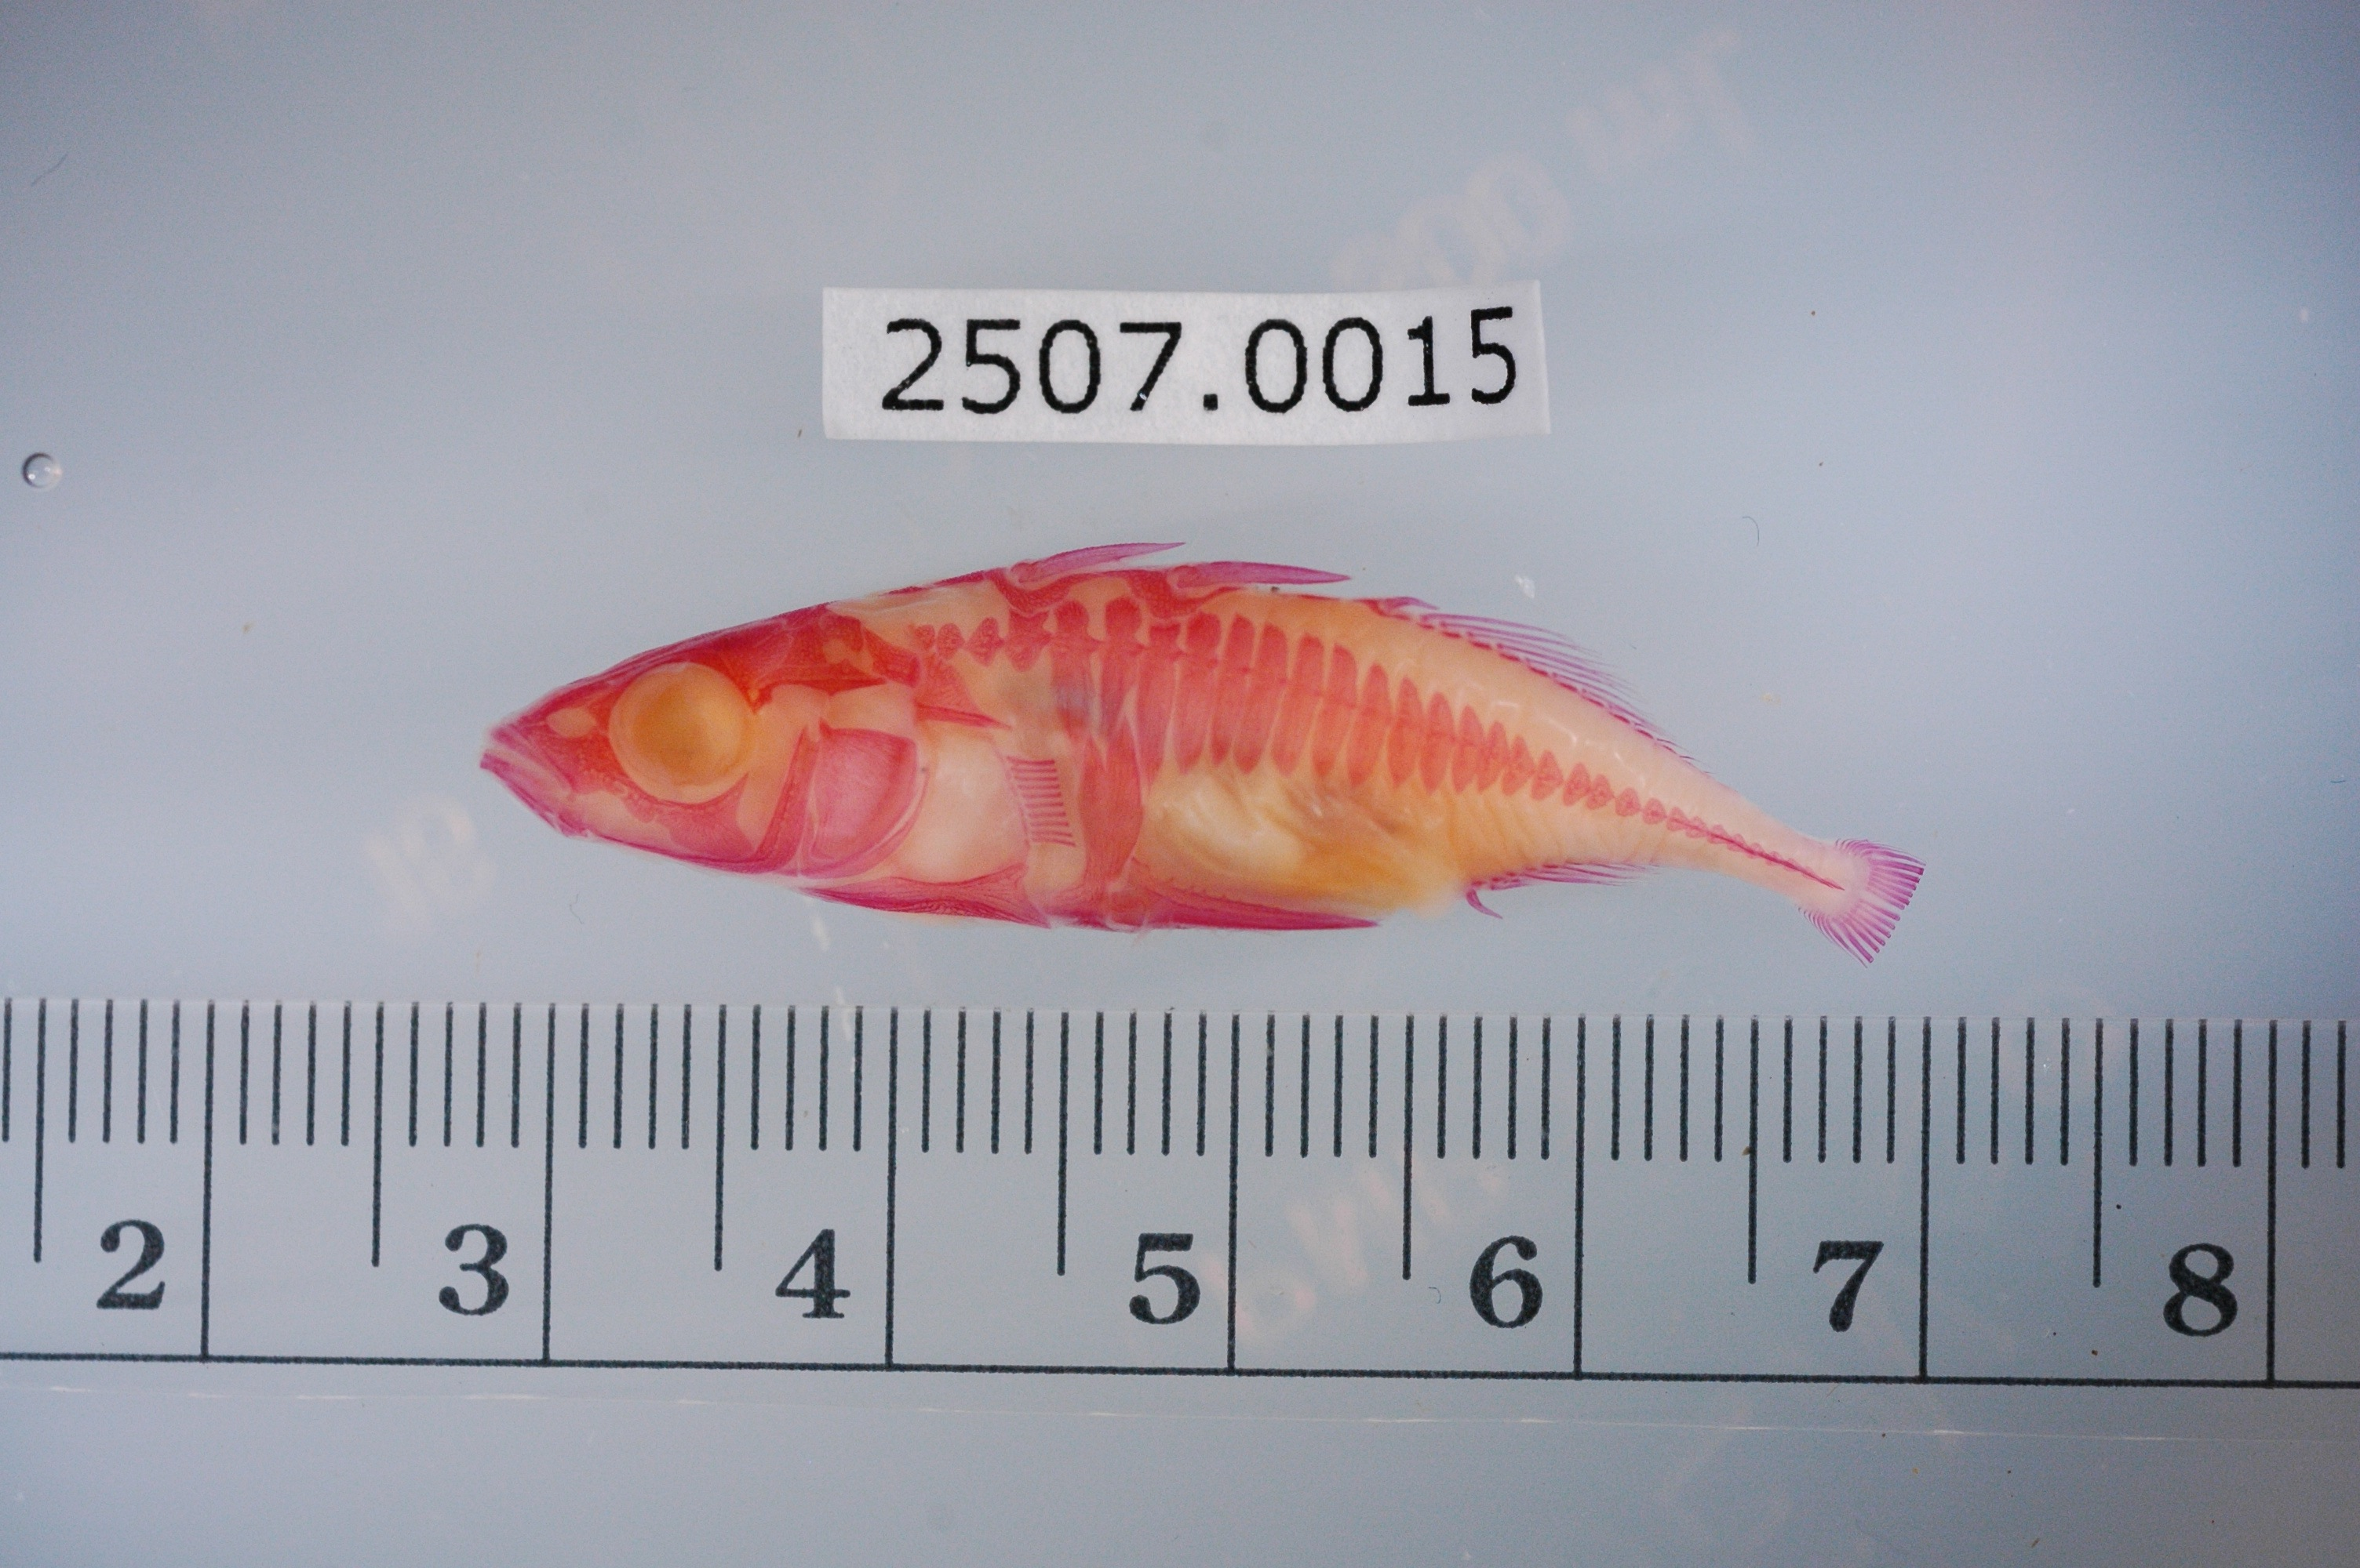
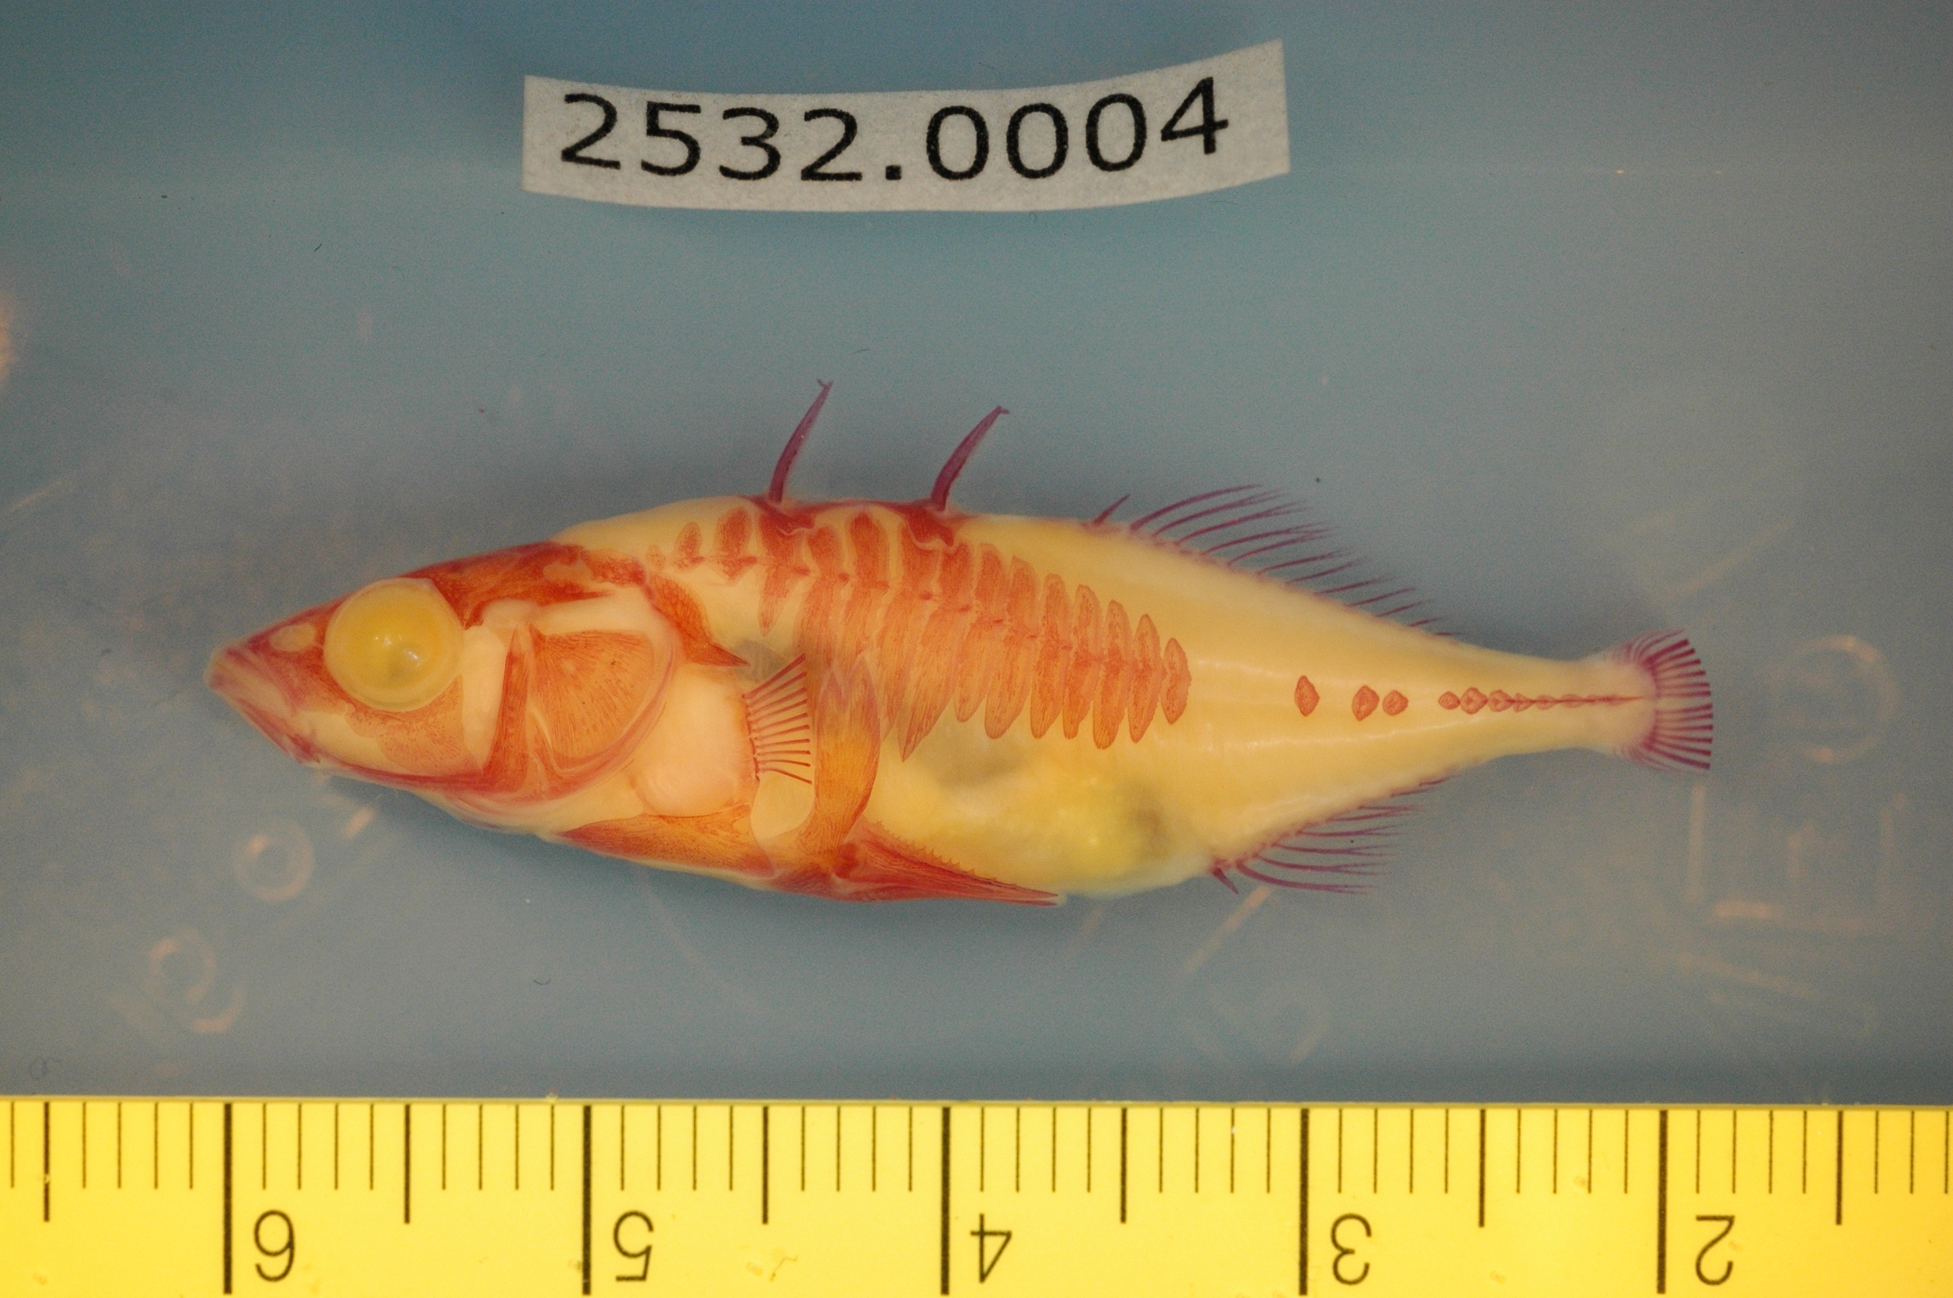
Confounders
Beyond the format of the data good datasets have limited irrelevant confounders
ML picks up on patterns, so you don’t want to add your own that might not be relevant to the question you’re asking
Columbia River
Riverbend

Slide 9
Example Differences between Reproducible and AI-Ready
Blurry Image results from Bad Calibration
Useful for your future-self to debug
Not useful for training an ML model
An instrument is broken, so you’re missing a variable
Useful if you don’t need that variable
Not useful for training an ML model that needs that variable
Contaminated Sequences
Useful for your future-self to debug
Not useful for training an ML model
You switch units on an instrument
Useful it’s still the same data
Not useful for training an ML model you must convert to consistent units in advance
When taking data consider recording whether your confident if that data should be used for science or if there is a possibility something went wrong. This can help you clean your data for ML projects, can True/False, or more fine grained red/yellow/green.

Slide 10
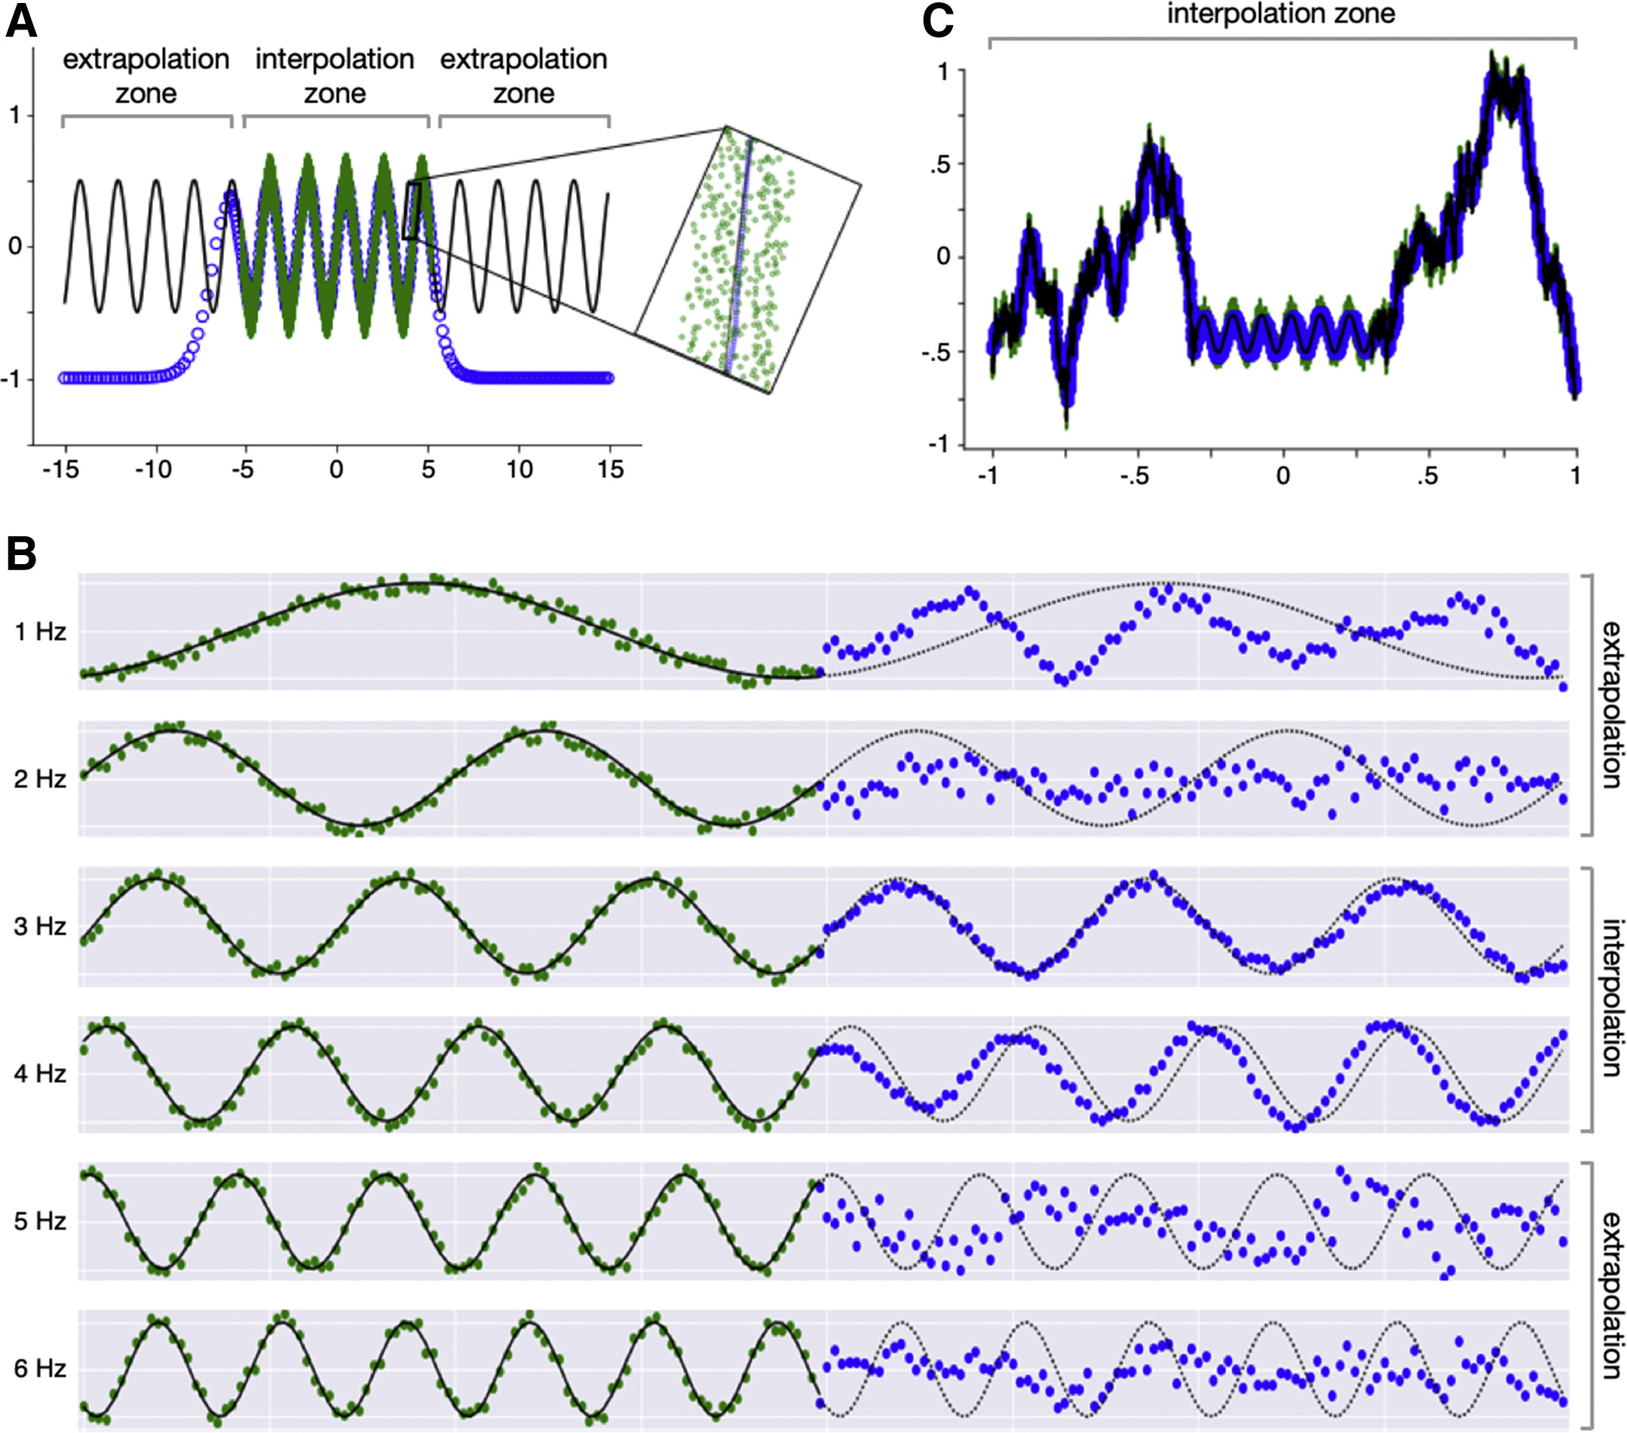
Extrapolation
ML does a lot of neat things, but it isn’t magic
Unless specified treat ML algorithms as universal function approximators
i.e. ‘Linear’ regression is not a universal function approximator
If you’re collecting data make sure you collect ’representative’ samples

Slide 11
Algorithms Concepts
Algorithms are selected to meet the data
Structured
Anything that would fit in a spread sheet
Each row is an example each column is a variable
Unstructured
Text, images, sequences, etc.
Variable length or sizes
Datasets are a consistent set of examples with optional labels

Slide 12
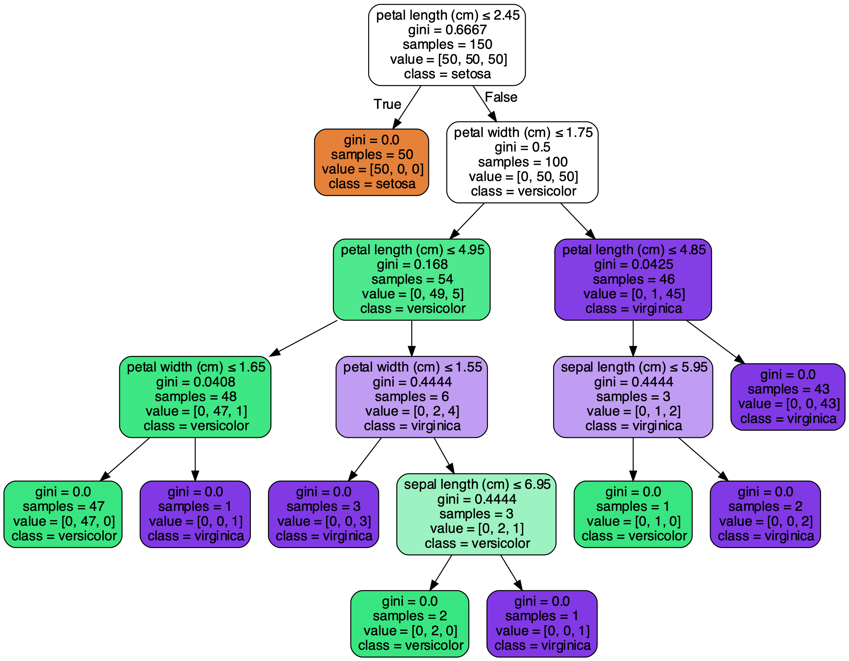

Random Forest
Decision Tree
Decision Forest

Slide 13

Neural Networks
A bit tricker to work with than decision tree
Need to be careful about data normalization
Training may not actually be better than a boosted decision tree
Why use them?
Offers tremendous flexibility
Can use any differential loss function
Has excellent performance if tuned

Slide 14
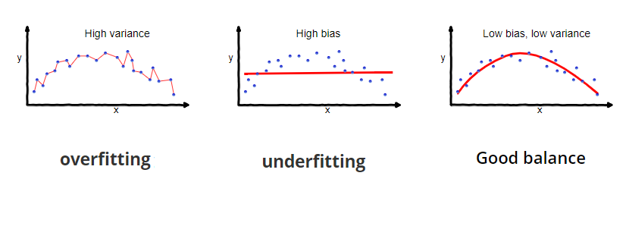
Bias Variance Tradeoff
https://towardsdatascience.com/understanding-the-bias-variance-tradeoff-165e6942b229

Slide 15
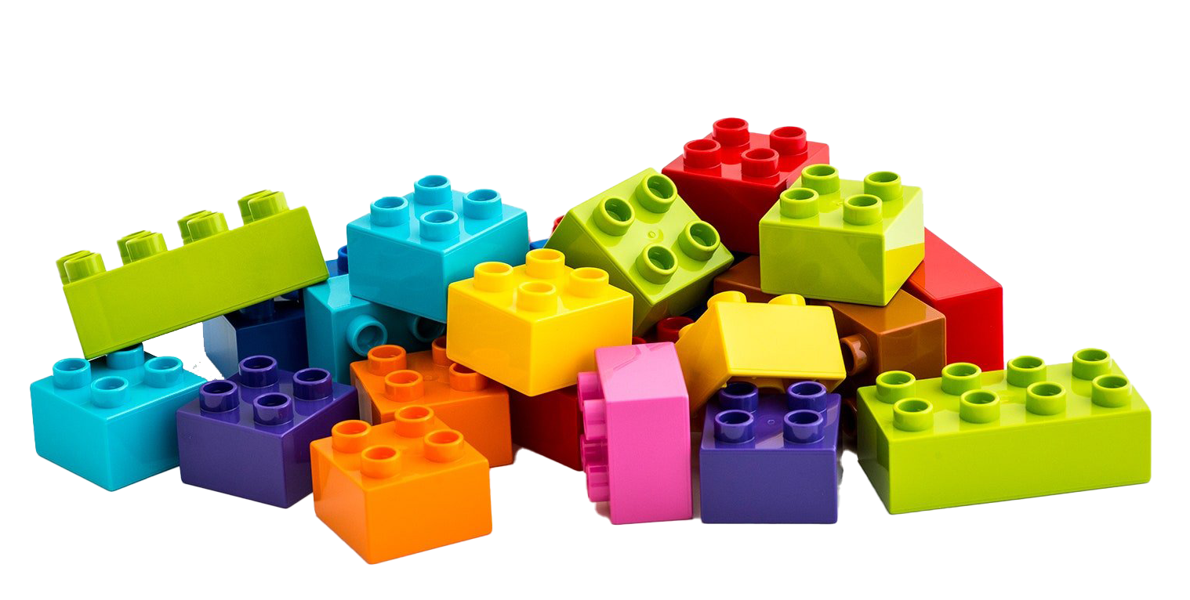
Deep Learning
Unlike the above algorithms Deep Learning doesn't neatly fit into an R packages
It’s better to think of it as a box of Lego blocks
Deep Neural networks are made up of layers
Layers exist for text, images, structured data, etc.
Allows for building and training custom models
This models are often made available

Slide 16
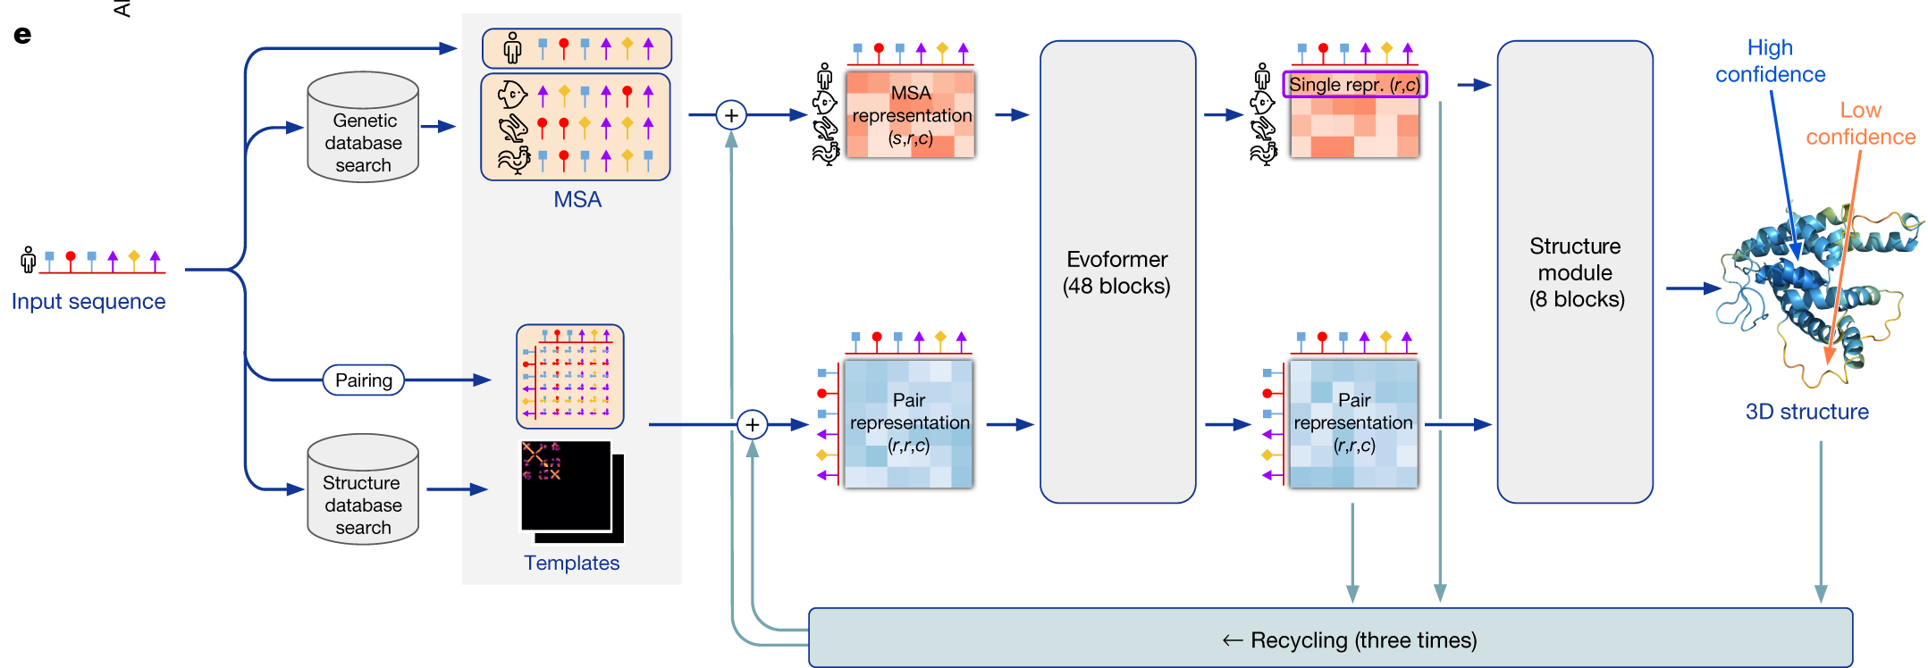
Example Alpha Fold (Protein Structure Prediction)

Slide 17
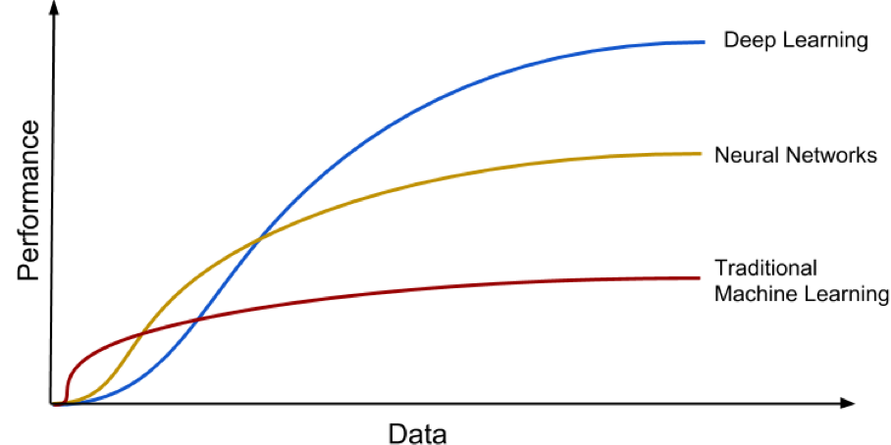
Models have different learning curves

Slide 18
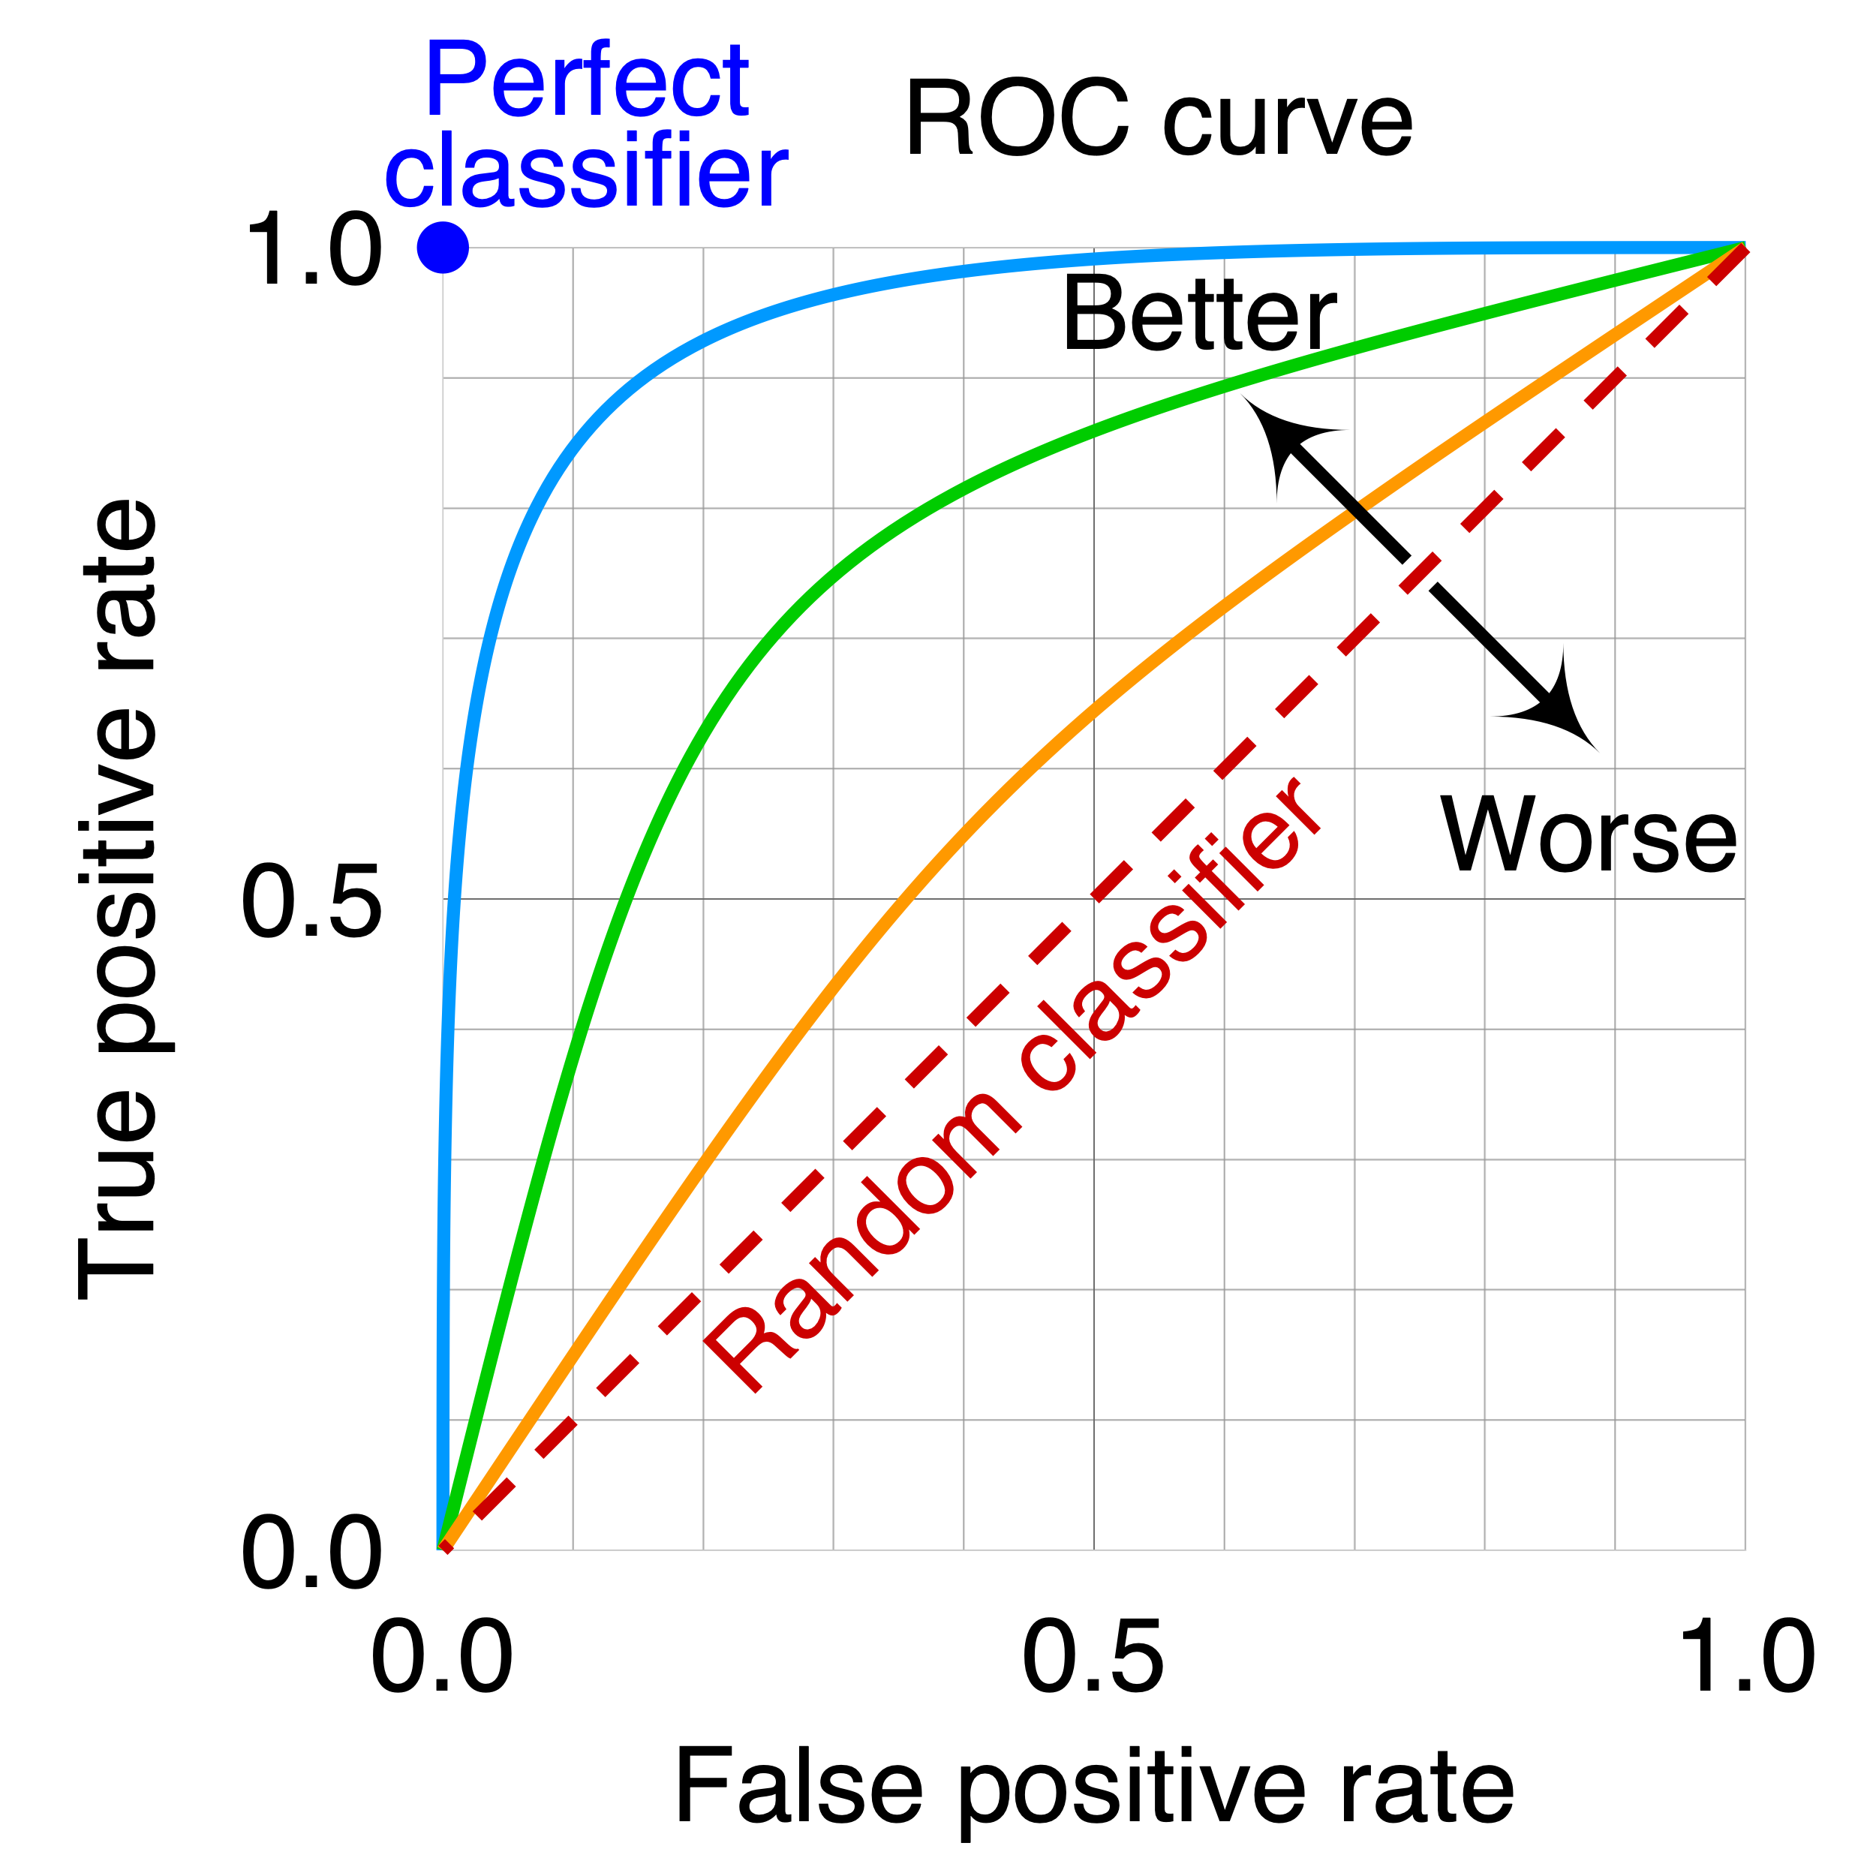
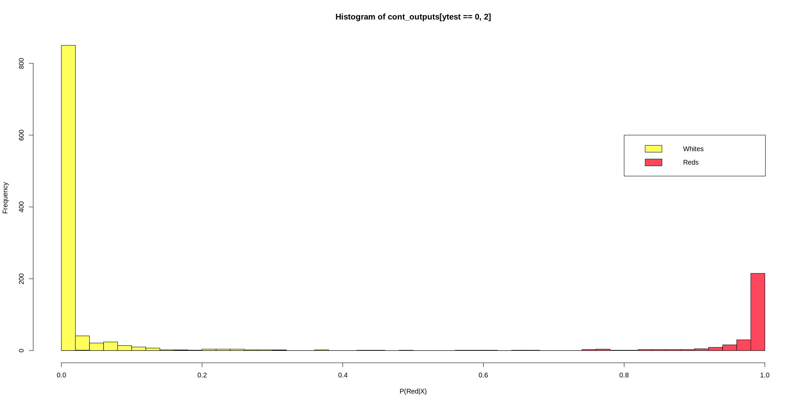
Model Evaluation ROC Curves
It can be a bit more complicated as we often don’t just know the decision we can get a probability
By default most tools assume >0.5 is True, but it isn’t required
You can give this Receiver Operator Characteristic
AUC = Area under Curve with 1 being the best

Slide 19
This week
We’ll working on preparing sequencing data
The kinds of data and how much you need
We’ll apply some of the algorithms we use before on sequencing data
We’ll write a Deep Learning Algorithm
We’ll explore common tasks in gene expression data and unsupervised techniques to make them work.

